Slide 1

The 'New Tool On The Block': Playwright!
https://github.com/BMayhew/playwright-demo

Slide 2
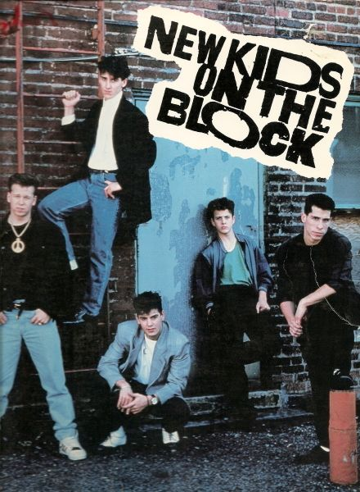
The 'New Tool On The Block': Playwright!
https://github.com/BMayhew/playwright-demo

Slide 3

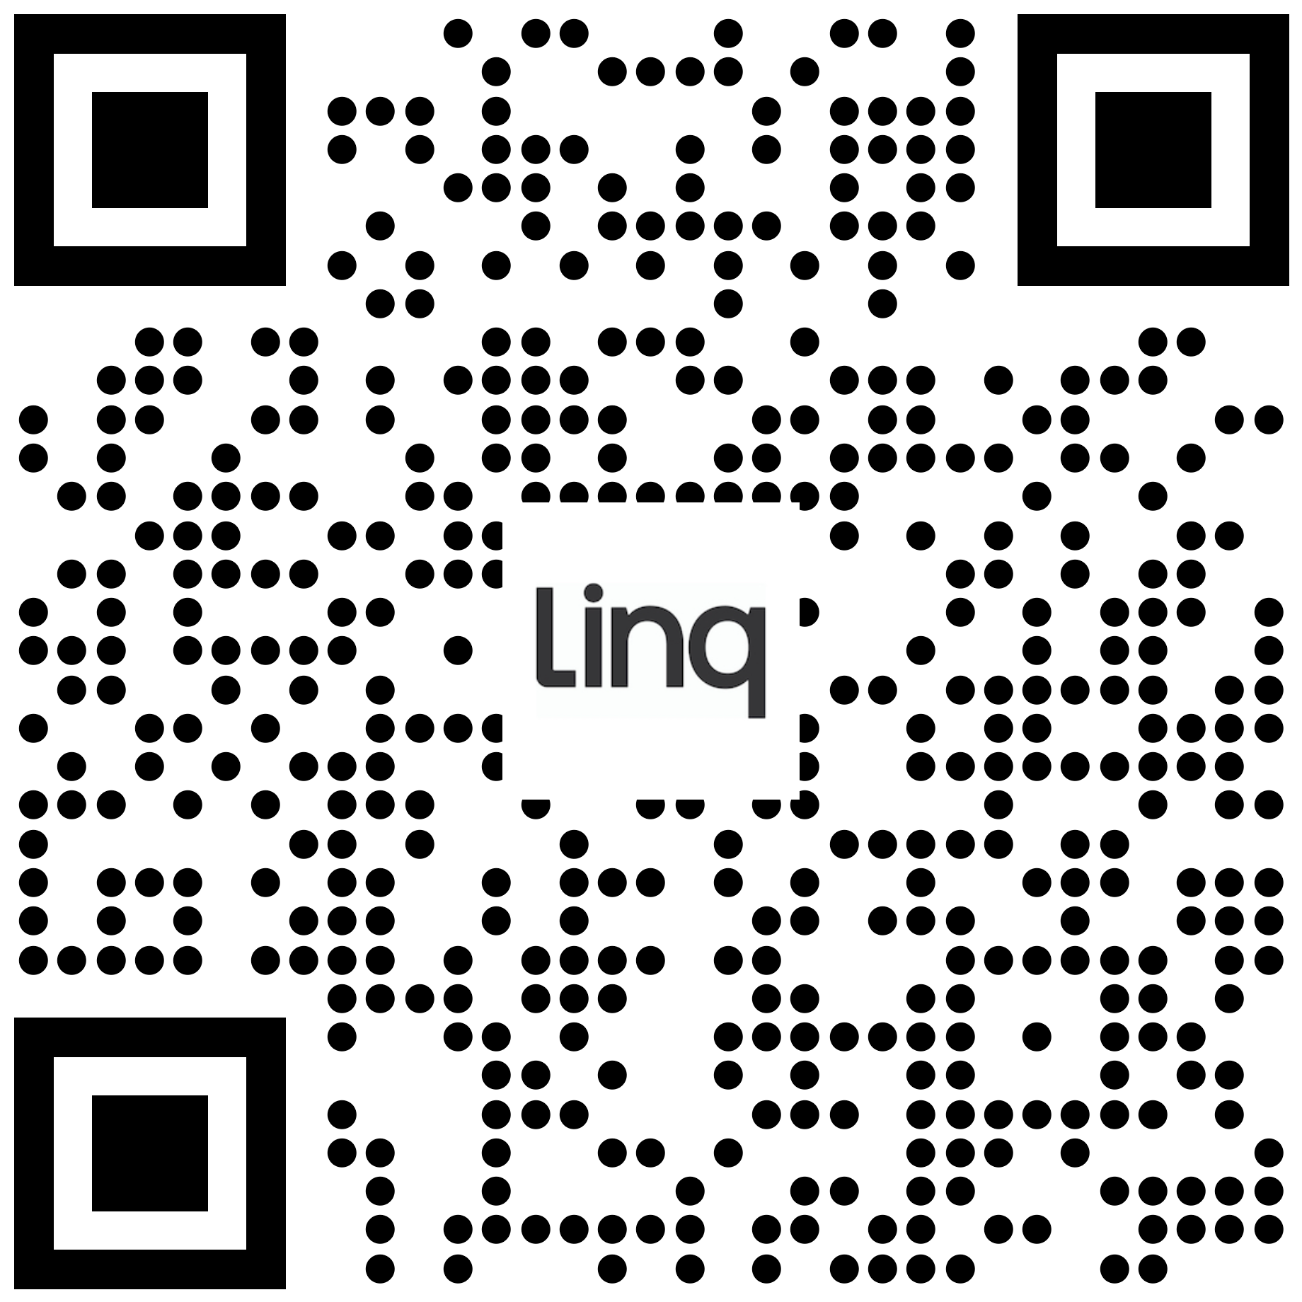
HOWDY 👋 I’m
Butch Mayhew
https://github.com/BMayhew/playwright-demo

Slide 4

Automate All the Things

Slide 5
Automate All the RIGHT Things
At the right levels:
Unit/component tests
API regression tests
UI regression tests
Smoke tests
Performance tests
Security tests

Slide 6
Automate All the RIGHT Things
At the right levels:
Unit/component tests
API regression tests
UI regression tests
Smoke tests
Performance tests
Security tests

Slide 7
Automate All the RIGHT Things
At the right levels:
Unit/component tests
API regression tests
UI regression tests
Smoke tests
Performance tests
Security tests
You can’t automate away exploratory testing

Slide 8
Automate All the RIGHT Things
At the right levels:
Unit/component tests
API regression tests
UI regression tests
Smoke tests
Performance tests
Security tests
You can’t automate away exploratory testing
BUT you can automate boring checks (test cases)

Slide 9
Automate All the RIGHT Things
At the right levels:
Unit/component tests
API regression tests
UI regression tests
Smoke tests
Performance tests
Security tests
You can’t automate away exploratory testing
BUT you can automate boring checks (test cases)
Big fan of using automation in testing – frees me up to apply critical thinking to the system/changes

Slide 10

Agenda
01 What is Playwright?
Overview of Playwright + history
02 Default State
Playwright config, globalSetup.ts overview, and environment variables
03 Running the Suite
Debugging, skip, only, and reporting
04 Overview of a UI Spec
Login spec – simple
onboarding spec – complex

Slide 11

What is Playwright?
Playwright enables reliable end-to-end testing for modern web apps

Slide 12
Default State
What state are we expecting our tests to start to help with speed!
Playwright config TOP 4
globalSetup.ts overview
Environment variables

Slide 13
DEMO

Slide 14
Default State
What state are we expecting our tests to start to help with speed!
Playwright config TOP 4
globalSetup.ts overview
Environment variables

Slide 15


Slide 16


Slide 17
DEMO

Slide 18
Running Suite
Debugging
Skip and only
Reporting

Slide 19
DEMO

Slide 20
Overview Spec
Login – simple UI
Delete User Account - API
Register User – complex UI

Slide 21
Best Practices
Write independent automated tests – remove as many dependencies as possible, tests shouldn’t share data between themselves
Setup data/state via API calls
Utilize static data when absolutely necessary (make sure there is an easy way to create static data against any new environments)
Leave state the same way you found it (the framework handles this for us)
Create re-usable methods/functions (page object model)
If #1 is true, we can run all tests in parallel 🏃💨
Goal of suite is catching regressions

Slide 22
THANK YOU!
ANY QUESTIONS?
Connect with me!

Slide 23
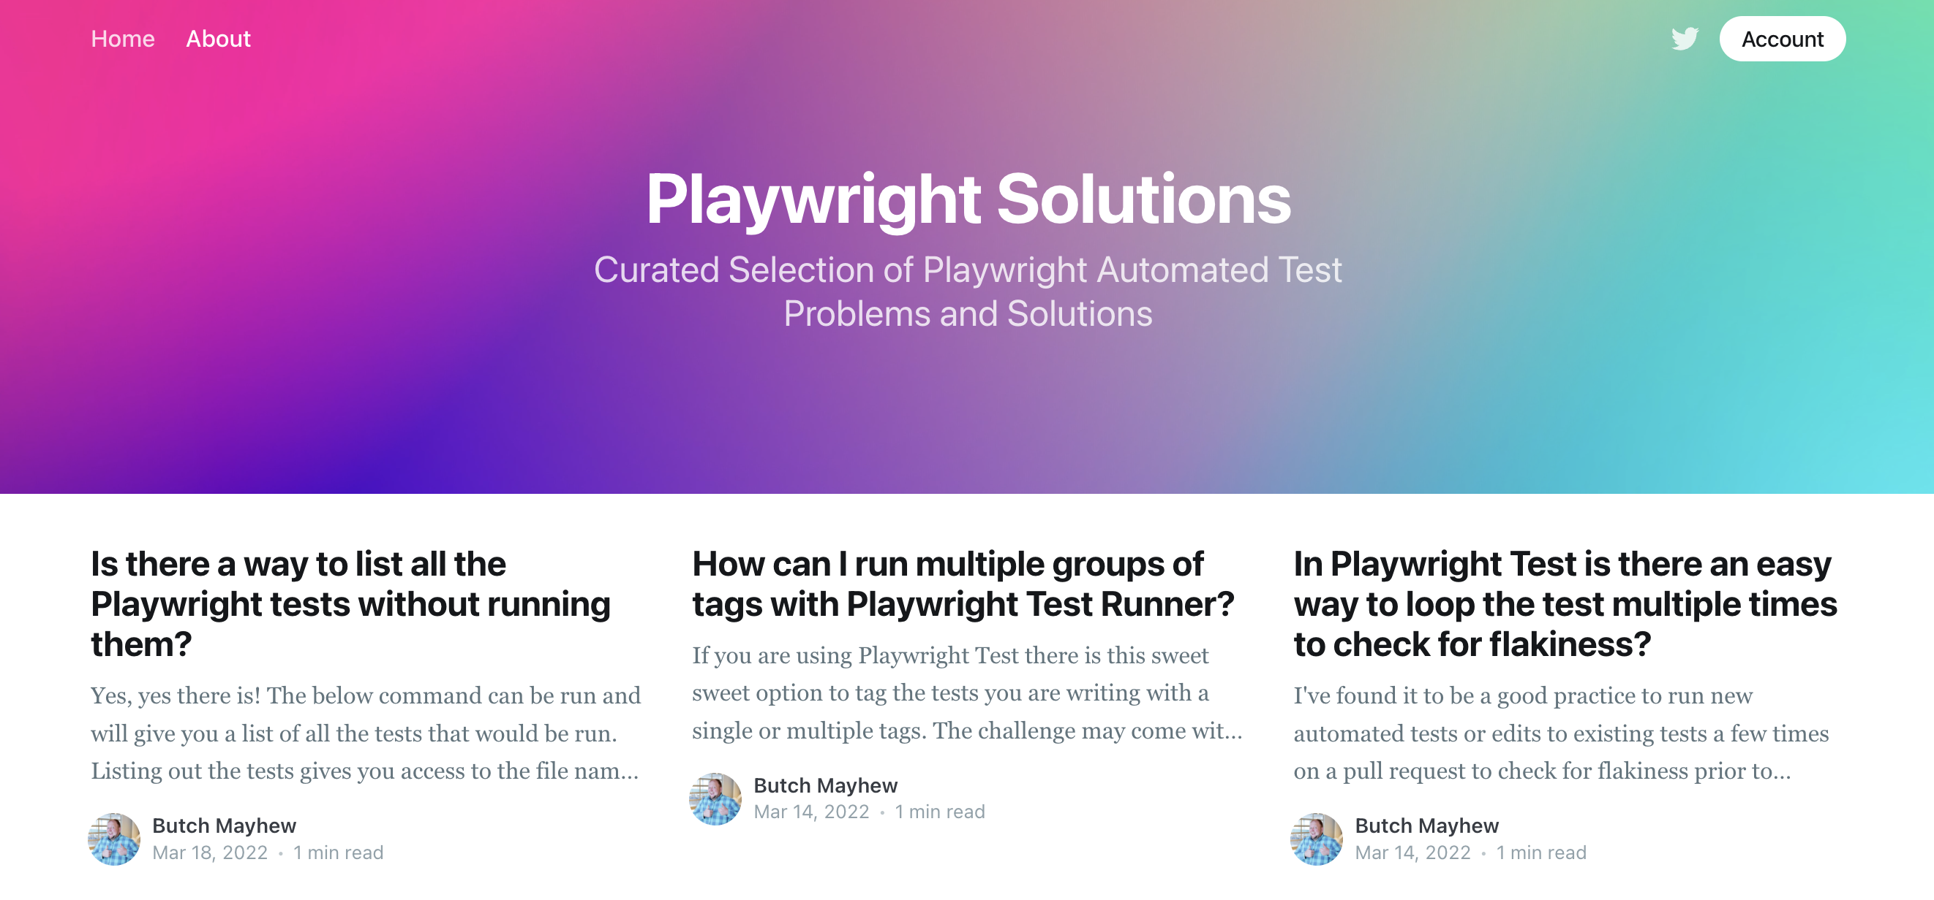
https://playwrightsolutions.com
THANK YOU!
ANY QUESTIONS?

Slide 24

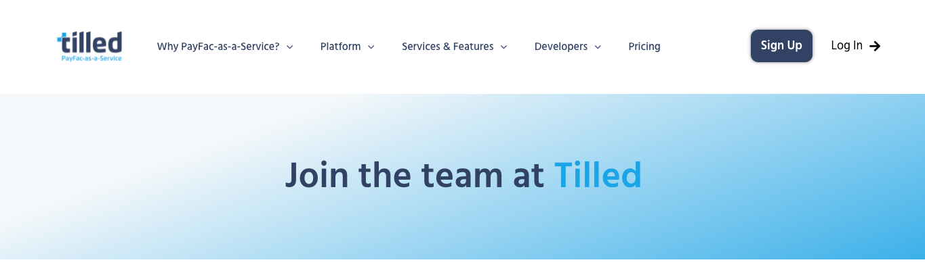
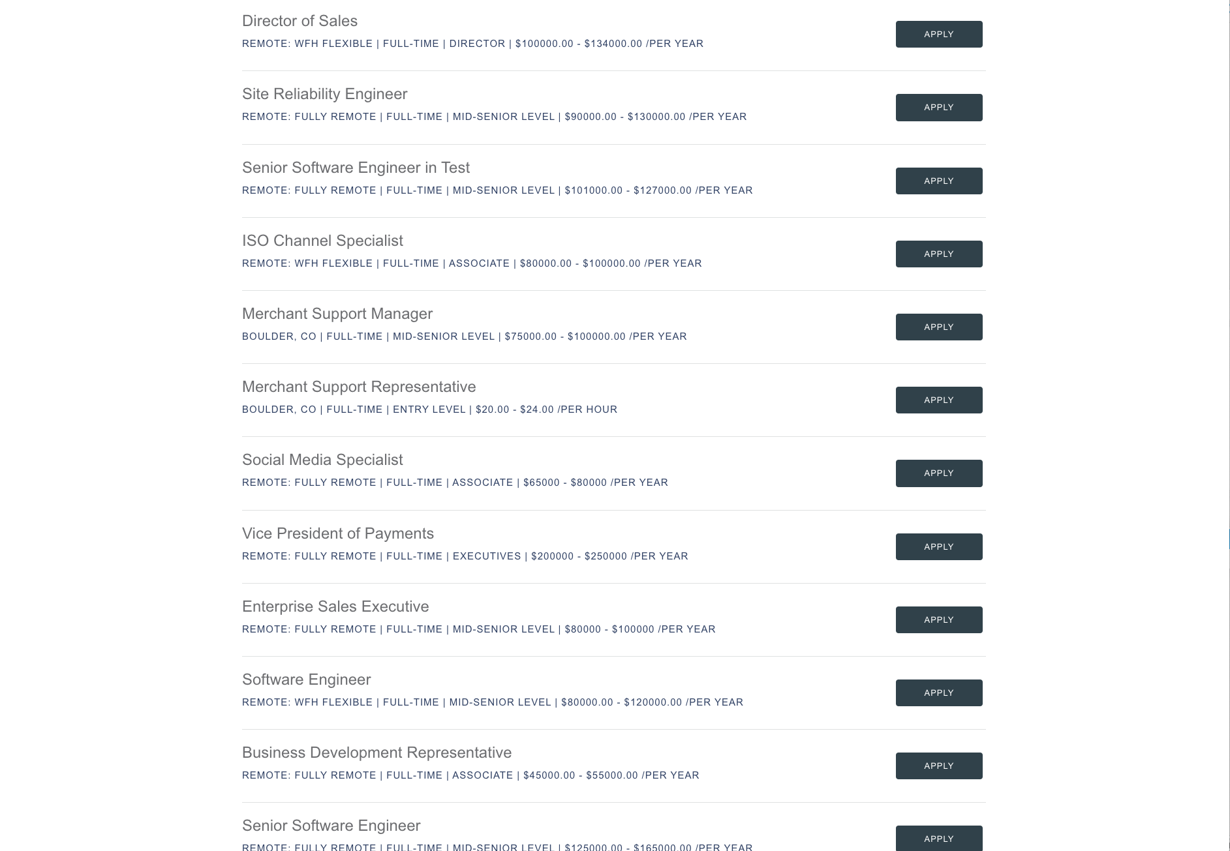
We’re Hiring!
We’d love for you to join our crew.
Get Started: tilled.com/careers

Slide 25
Connect
With Me!
https://github.com/BMayhew/playwright-demo

